Slide 1
CAPSTONE : Finance and Risk Analytics (Portfolio Management)
By:
Santapuri Jayavardhan Rayudu

Slide 2
Agenda
Objective
Background
Suggested Portfolio‘s
Sectorwise Analysis
Metrics
Combinations
Appendix

Slide 3
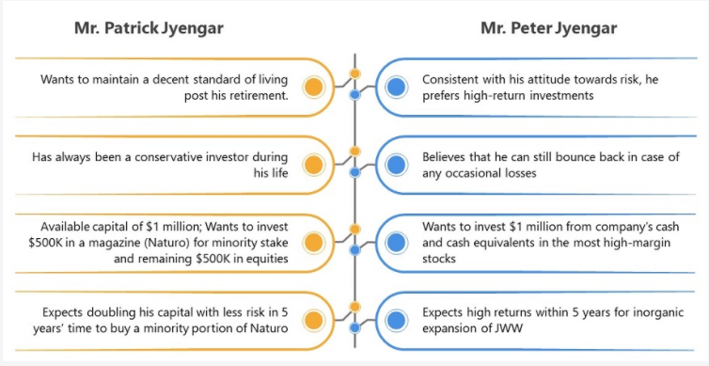
Objective
Creating a Portfolio for the Investors ( Mr. Patrick Jyengar and Mr. Peter Jyengar).
Analyising the different sectors with comparision to Index and investor‘s mentality to create suitable portfolio.
Explaining the resons for the created Portfolio‘s.

Slide 4
Background
Mr. Peter and Mr. Patrick Jyengar have different mentalities and different expectations.
Mr. Peter is a risk taking investor and Mr. Patrick is a safe investor.
Among the last Five years, the performance of various sectors have been different. For example: At the time of Covid-19, the Aviation sector was badly effected and the Pharma along with Technology sector gained huge market.

Slide 5
Suggested Portfolio‘s
 | Mr. Patrick Jyengar | Mr. Peter Jyengar
Invested amount | $500,000 | $1000,000
Risk (Expected) | Low | Doesn’t matter
Return (Expected) | Double | More
Suggested portfolio | Johnson_and_Johnson(JNJ) , Roche_Holding(RHHBY) , Merck_and_CO(MRK) and Amazon(AMZN) | Microsoft(MSFT) and Amazon(AMZN)
Portfolio risk | 17.18 | 26.5
Portfolio return | $1143367.8 | $5523971.8
Earnings | $643,367.8 | $4,523,971.8
Note: Index S&P500 has a risk of 19.18.

Slide 6
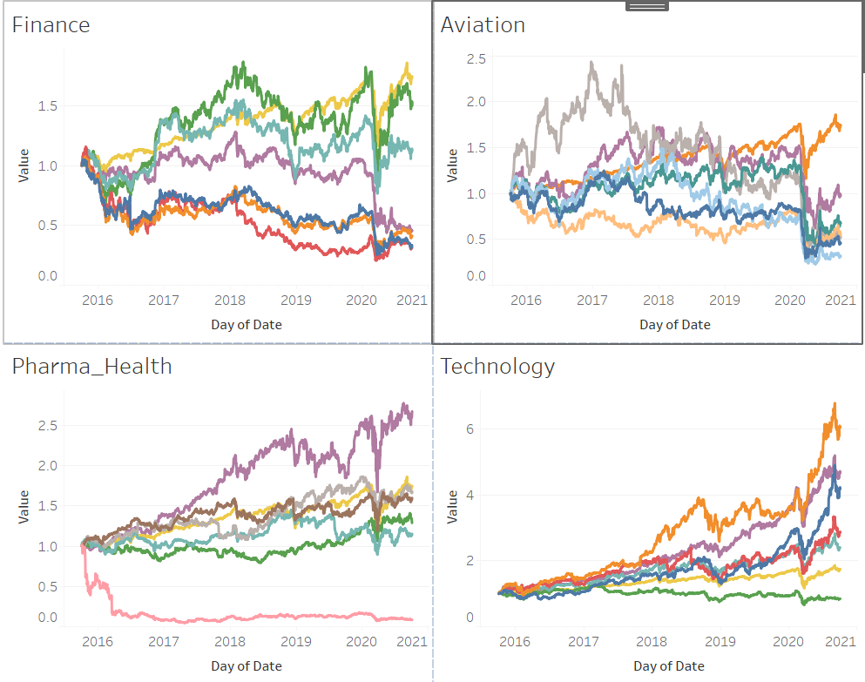
Sectorwise Analysis
In this, we can clearly observe that Technology and Pharma sectors were good performers and were in sync with index (S&P500).
Aviation sector wasn‘t contributing much to the index.
Finance sector has been moderate for the last five years.

Slide 7
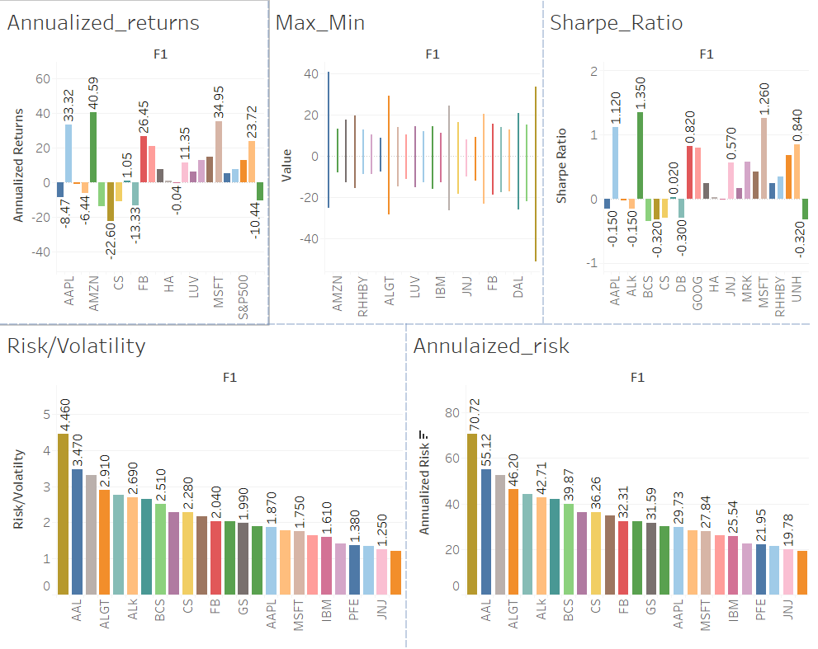
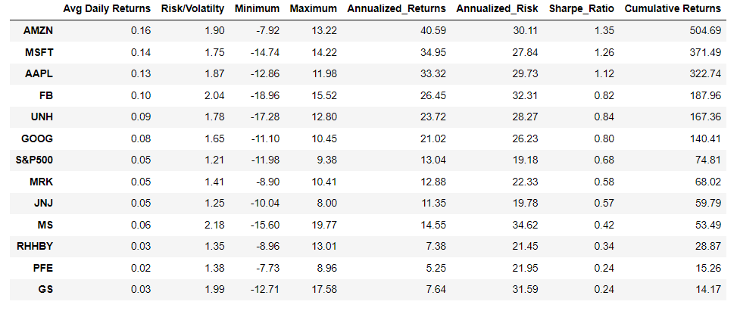
Metrics
Among all the 25 stocks, 13 stocks with positive returns have been shortlisted.
Among the shortlisted stocks, the portfolio has been selected based on risk of the index (19.18) and portfolio.
Risk and returns of the portfolio combinations were compared to select the Ideal one based on customer expectations.

Slide 8
Combinations
Mr. Patrick Jyengar | First | Second | Third
Portfolio | Johnson_and_Johnson(JNJ) , Roche_Holding(RHHBY) , Merck_and_CO(MRK) and Microsoft (MFST) | Johnson_and_Johnson(JNJ) , Roche_Holding(RHHBY) , Merck_and_CO(MRK) and Google (GOOG) | Johnson_and_Johnson(JNJ) , Roche_Holding(RHHBY) , Merck_and_CO(MRK) and Amazon(AMZN)
Risk | 18 | 17.25 | 17.18
Return | 1058232.5 | 895233.1 | 1143367.8
Note: Mr. Peter Jyengar has only one combination which is Microsoft (MSFT) and Amazon (AMZN).

Slide 9
Appendix
  Data Sources : Dataset (1).rar
  Python file: Finance and Risk Analytics - Capstone Project.ipynb
  Visualization files: Visualization
  Datasets: Datasets
  Data Model Assumptions:
    History shall repeat (The pattern of last five years will be repeated for next five years).

Slide 10
Thank you

